Slide 1
OOP Basic Concept
By Hermawan

Slide 2
The Evolution of the OOP
OOP is a kind of Programming language evolution,
The Generations of programming language:
Machine Language (1949 ): binary code of CPU
Assembly Language (1950–1960): Autocode, Assembly, Algol, Cobol, Fortran
Procedural Language (1960–1980): Basic, Pascal, C
Object Oriented Language (1980–1990): C++, ADA, Eifel
OO Framework Language (1990-Now): Java, Python, Visual Basic, C#
Functional Language : Java Script, SQL, Lambda

Slide 3
The Evolution of the OOP Machine Language
[ op | rs | rt | rd |shamt| funct]
0 1 2 6 0 32 decimal
000000 00001 00010 00110 00000 100000 binary

Slide 4
The Evolution of the OOP Assembly Language
INC EDX ; increment register counter EDX
CMP EDX, 10 ; Compares whether the counter has reached 10
JLE LP1 ; If it is less than or equal to 10, then jump to LP1

Slide 5
The Evolution of the OOP Procedural Language
procedure findMin(x, y, z: integer; var m: integer);
(* Finds the minimum of the 3 values *)
begin
if x < y then
m := x
else
m := y;
if z <m then
m := z;
end; { end of procedure findMin }

Slide 6
The Evolution of the OOP Basic Object Language
Basic object attribute in C language
typedef struct {
char* name;
int age;
} Student;
int main() {
Student *adi;
setStudent(adi, “adi darmawan”, 18);
display(adi);
}
void setStudent(Student *s, char* n, int a){
s->name = age;
s->age=a;
}
void display(student *s) {
printf("\nDisplaying information\n");
printf("Name: %s", s->name);
printf("\nAge: %d", s->age);
}

Slide 7
The Evolution of the OOP Basic Class of Object Language
Class of Object with attribute+method in C++ language
Class Student {
private:
char name[50];
int age;
public:
void setStudent(char n, int a){
s.name = age;
s.age=a;
}
void display(struct student s) {
printf("\nDisplaying information\n");
cout<<"Name: "<<name;
cout<<"\nAge: "<<age;
}
int main() {
Student adi;
adi.setStudent(“adi darmawan”, 18);
adi.display();
}
};

Slide 8
The Evolution of the OOP Basic Class of Object Language
Why Class of Object is needed….?
Modularity, programs can communicate with another transparently
Productivity, allows to break the program into the bit-sized problems
Reusability, eliminate redundant code and extend the use of existing classes.
Security, data hiding helps to secure programs which cannot be invaded by the code in other parts of the program
Visibility, use template to manage programs by contract

Slide 9
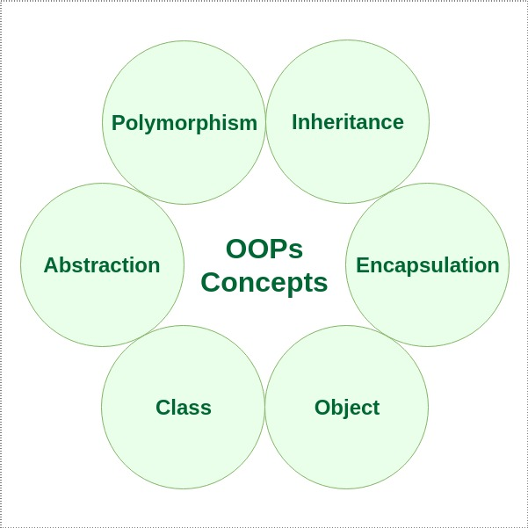
Object Oriented Programming

Slide 10
Object Oriented Programming Class & Object

Slide 11
Object Oriented Programming Class & Object
A class is a template for objects. A class defines object properties including a valid range of values, and a default value. A class also describes object behavior. An object is a member or an "instance" of a class.
Class: Human
Object: Man & Woman
Human man = new Human;
Human woman = new Human;
Human: Class
Man: Object 1
woman: Object 2

Slide 12
Object Oriented Programming Class vs Object
No | Class | Object
1 | Class is used as a template for declaring and creating the objects. | An object is an instance of a class.
2 | When a class is created, no memory is allocated. | Objects are allocated memory space whenever they are created.
3 | The class has to be declared only once. | An object is created many times as per requirement.
4 | A class cannot be manipulated as they are not available in the memory. | Objects can be manipulated.
5 | A class is a logical entity. | An object is a physical entity.
6 | It is declared with the class keyword | It is created with a class name in C++ and with the new keywords in Java.
7 | Class does not contain any values which can be associated with the field. | Each object has its own values, which are associated with it.
8 | A class is used to bind data as well as methods together as a single unit. | Objects are like a variable of the class.

Slide 13
Object Oriented Programming Class & Object Hierarchy
Instance
Generalization
Aggregation/
Composition
Vehicle
Is a
Has a
Bicycle
Moto
Car
Train
Aircraft
Manual bike
Electric Moto
Gasoline Moto

Slide 14
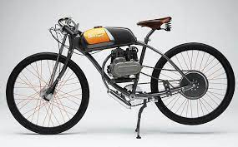

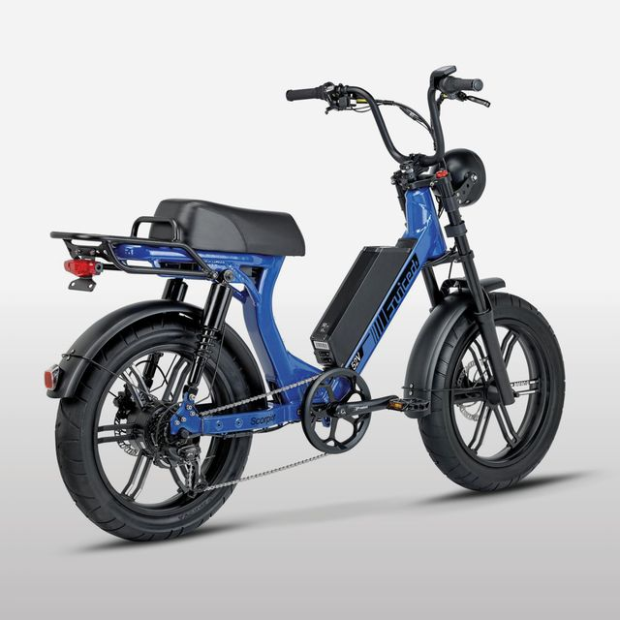

Object Oriented Programming Class & Object

Slide 15
Object Oriented Programming Class & Object Properties
Attributes
Attributes are an object's data
Properties
Methods
Methods are an object's Operation

Slide 16
Object Oriented Programming Class & Object Properties
Fuel
Speed
Body
Wheel
Drive
Payload
Engine
Weight
Vehicle
Start
Accelerate
Break
Stop
Sign

Slide 17
Object Oriented Programming Class in UML Model

Slide 18
Object Oriented Programming Class in Java
public class Vehicle {
private String body;
private byte wheel;
private String drive;
private int payload;
private byte passenger;
private String size;
private byte weight;
private String fuel;
private byte fuelLevel;
private String engine;
private String speed;
private boolean start;
private byte accelerate;
private byte brake;
private boolean stop;
private boolean off;
private char turn;
……….
public String getBody() {
return body;
}
public void setBody(String body) {
this.body = body;
}
public byte getWheel() {
return wheel;
}
public void setWheel(byte wheel) {
this.wheel = wheel;
}

Slide 19
Object Oriented Programming Object in Java
public static void main(String args[]){
Vehicle car = new Vehicle();
car.setStart(true);
car.accelerate=5;
car.brake=4;
car.getSpeed();
car.setStop(true);
car.setOff(true);
car.isOff();
}
Instance Object Constructor
Car is a Vehicle
Mutator Method
Set the object value
Accessor Method
Get the object value

Slide 20
Quiz 1
What is Class and Object in OOP….?
What is different of Class and Object….?
How to create a new Object from a Class in Java OOP….?
What is Mutator and Accessor method…?
Create a Class with has minimal 5 attribute and 5 method.

Slide 21
Reference
Object-Oriented Analysis and Design with Applications 3th edition, Addison Wesley, Grady Booch.
Object-Oriented Analysis and Design, Springer, Brahma Dathan.
https://www.geeksforgeeks.org/

